Slide 1
Module 4 Live Session: Intro to Neural Networks
IMT 575
Bill Howe

Slide 2
Agenda
Instructor Introduction (10 minutes)
Open Q&A on Module and Lab (20 minutes)
Reading Response (15 minutes)
Demo and Discussion (20 minutes)
Discussion on Gradient Descent and Backpropagation (20 minutes)
Review (5 minutes)

Slide 3

What is Deep Learning (DL) ?
A machine learning subfield of learning representations of data. Exceptional effective at learning patterns.
Deep learning algorithms attempt to learn (multiple levels of) representation by using a hierarchy of multiple layers
If you provide the system tons of information, it begins to understand it and respond in useful ways.
https://www.xenonstack.com/blog/static/public/uploads/media/machine-learning-vs-deep-learning.png
slides adapted from Ismini Lourentzou

Slide 4
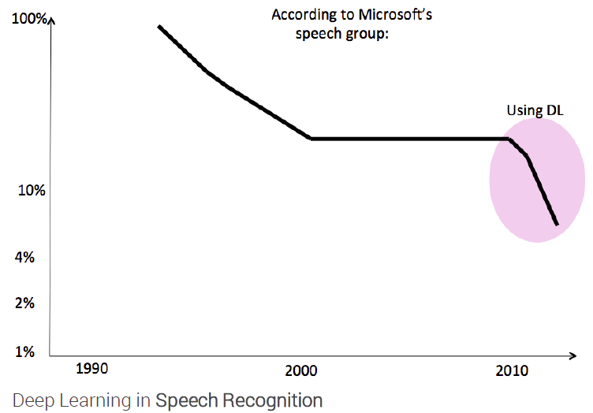
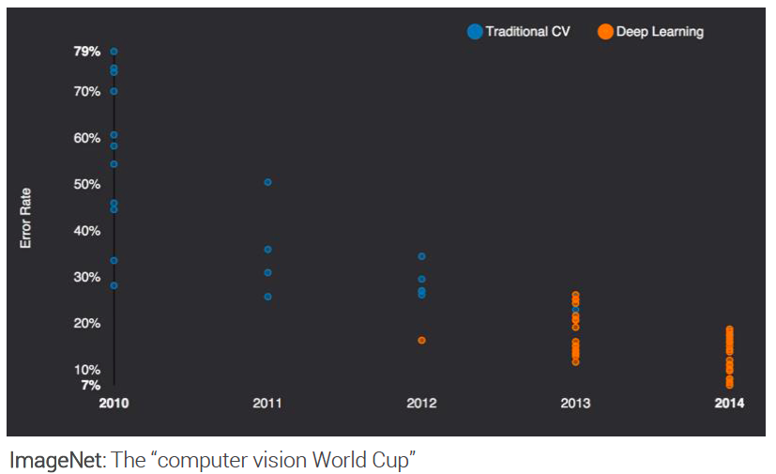
State of the art in …
Several big improvements in recent years in NLP
Machine Translation
Sentiment Analysis
Dialogue Agents
Question Answering
Text Classification …
Leverage different levels of representation
words & characters
syntax & semantics
slides adapted from Ismini Lourentzou

Slide 5

Neurons
Blausen Medical

Slide 6
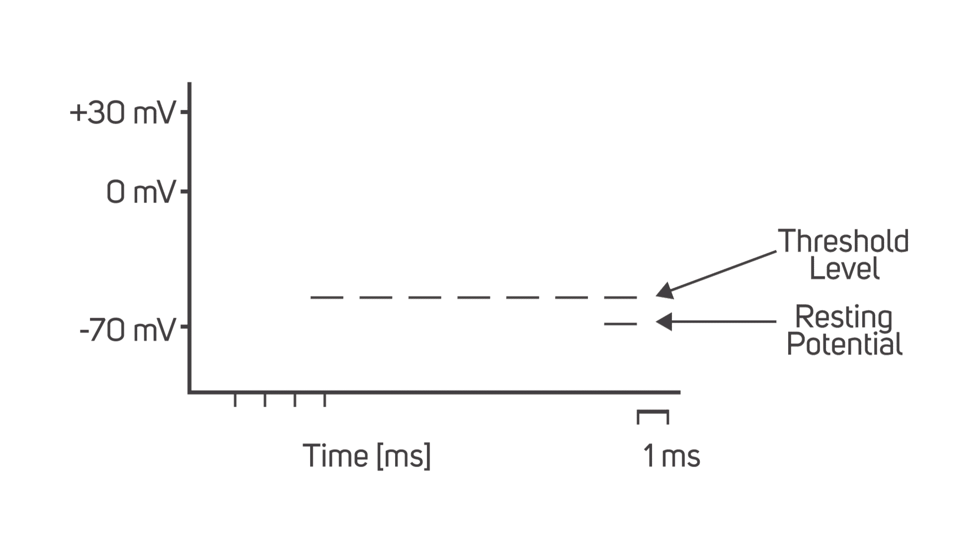
Neurons
Eric Chudler

Slide 7
The Perceptron
Rosenblatt’s (a psychologist’s) attempt at trying to mathematically model a neuron
The perceptron takes in a set of inputs, multiplies them by a weight, and then aggregates
Keep this process in mind! It is central to how neural networks work!
Perceptron “fires” if the aggregate reaches some threshold
Very much like the all-or-nothing response of a neuron

Slide 8
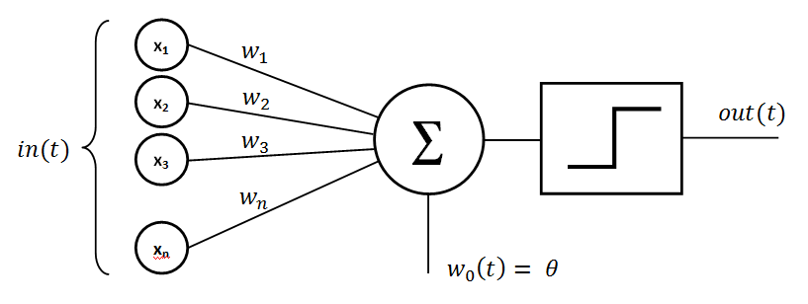
The Perceptron
Mayranna

Slide 9

The Perceptron
Stanford CS231n

Slide 10

The Perceptron
Stanford CS231n

Slide 11
The Perceptron
Stanford CS231n

Slide 12
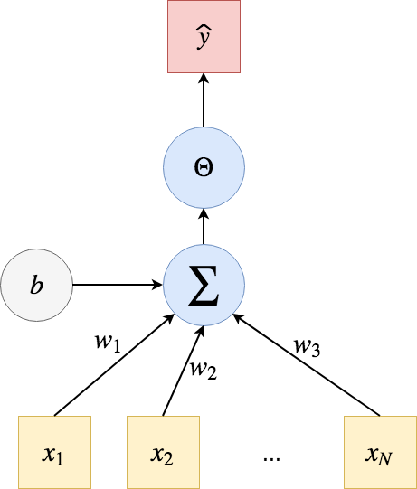
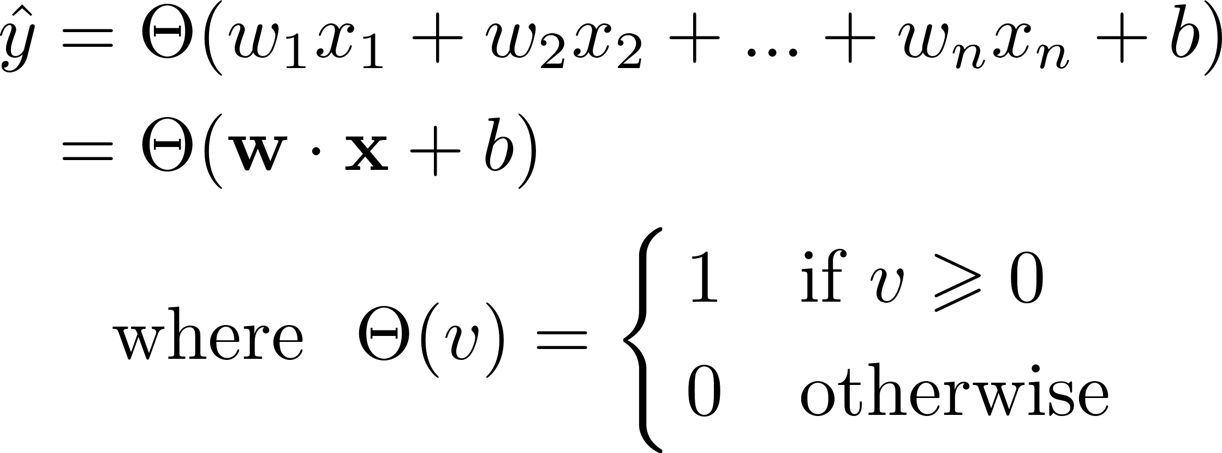
Perceptron: The earliest modern model of a neural network

Slide 13
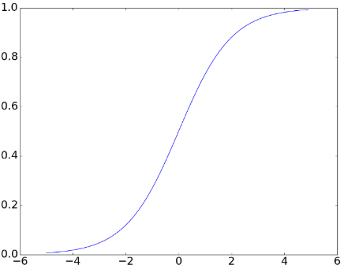
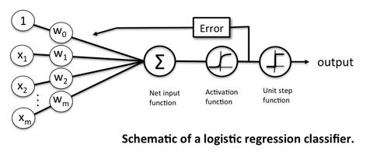

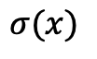
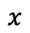
Logistic Regression as a neural network
$$h= σ(Wx+b)$$
$$σ(x)$$
$$x$$

Slide 14
Perceptron: The earliest modern model of a neural network
The idea (from the 50s and 60s) is that perhaps this model can compute anything at all. The game is this:
Say we have some interesting function f(x_{i})
Can we find values of w_{i} and b such that the equation above will produce the same answers as f?

Slide 15
Perceptron: The earliest modern model of a neural network
Part 1 of Lab!
The idea (from the 50s and 60s) is that perhaps this model can compute anything at all. The game is this:
Say we have some interesting function f(x_{i})
Can we find values of w_{i} and b such that the equation above will produce the same answers as f?

Slide 16
Perceptrons For Simple Logic Functions
X1 | X2 | Output
1 | 1 | 1
1 | 0 | -1
0 | 1 | -1
0 | 0 | -1

Slide 17
Perceptrons For Simple Logic Functions
AND
X1 | X2 | Output
1 | 1 | 1
1 | 0 | -1
0 | 1 | -1
0 | 0 | -1

Slide 18
Perceptrons For Simple Functions: Logic
AND
X1 | X2 | Output
1 | 1 | 1
1 | 0 | -1
0 | 1 | -1
0 | 0 | -1

Slide 19
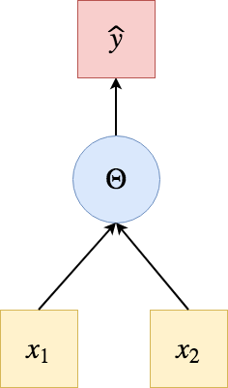
Perceptrons For Simple Functions: Logic
AND
X1 | X2 | Output
1 | 1 | 1
1 | 0 | -1
0 | 1 | -1
0 | 0 | -1
ONE POSSIBLE SOLUTION: w1 = 1, w2 = 1, b = -1.5

Slide 20
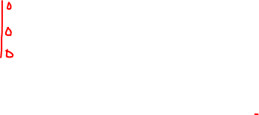
Perceptrons For Simple Functions: Logic
AND
X1 | X2 | Output
1 | 1 | 1
1 | 0 | -1
0 | 1 | -1
0 | 0 | -1
Θ(w1*
+ w2*
+ b) =
Θ(w1*
+ w2*
+ b) =
Θ(w1*
+ w2*
+ b) =
Θ(w1*
+ w2*
+ b) =
ONE POSSIBLE SOLUTION: w1 = 1, w2 = 1, b = -1.5

Slide 21
Perceptrons For Simple Functions: Logic
AND
X1 | X2 | Output
1 | 1 | 1
1 | 0 | -1
0 | 1 | -1
0 | 0 | -1
Θ(w1*
+ w2*
+ b) =
Θ(w1*
+ w2*
+ b) =
Θ(w1*
+ w2*
+ b) =
Θ(w1*
+ w2*
+ b) =
ONE POSSIBLE SOLUTION: w1 = 1, w2 = 1, b = -1.5

Slide 22
Perceptrons For Logic
OR
X1 | X2 | Output
1 | 1 | 1
1 | 0 | 1
0 | 1 | 1
0 | 0 | -1

Slide 23
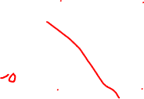
Perceptrons For Logic
OR
X1 | X2 | Output
1 | 1 | 1
1 | 0 | 1
0 | 1 | 1
0 | 0 | -1

Slide 24
Perceptrons For Logic
OR
X1 | X2 | Output
1 | 1 | 1
1 | 0 | 1
0 | 1 | 1
0 | 0 | -1
ONE POSSIBLE SOLUTION:
w1 = 1, w2 = 1, b = -0.5

Slide 25
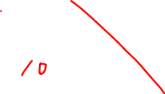
Perceptrons For Logic
OR
X1 | X2 | Output
1 | 1 | 1
1 | 0 | 1
0 | 1 | 1
0 | 0 | -1
Θ(w1*
+ w2*
+ b) =
Θ(w1*
+ w2*
+ b) =
Θ(w1*
+ w2*
+ b) =
Θ(w1*
+ w2*
+ b) =
ONE POSSIBLE SOLUTION:
w1 = 1, w2 = 1, b = -0.5

Slide 26
Perceptrons For Logic
OR
X1 | X2 | Output
1 | 1 | 1
1 | 0 | 1
0 | 1 | 1
0 | 0 | -1
Θ(w1*
+ w2*
+ b) =
Θ(w1*
+ w2*
+ b) =
Θ(w1*
+ w2*
+ b) =
Θ(w1*
+ w2*
+ b) =
ONE POSSIBLE SOLUTION:
w1 = 1, w2 = 1, b = -0.5

Slide 27
How Perceptrons Learned
In essence, the perceptron was a translation of inputs into outputs
The weights needed to perform these translations could be learned based on available data
One way: Rosenblatt’s algorithm from the 50s
Showed convergence when two criteria are met: data is linearly separable and step size is sufficiently (in the proof, infinitely) small

Slide 28
Perceptrons For Logic
XOR
X1 | X2 | Output
1 | 1 | 1
1 | 0 | -1
0 | 1 | -1
0 | 0 | 1

Slide 29
Perceptrons For Logic
XOR
X1 | X2 | Output
1 | 1 | 1
1 | 0 | -1
0 | 1 | -1
0 | 0 | 1
Not linearly separable!

Slide 30
Rosenblatt’s Perceptron
X₀
w₀
X₁
w₁
Σ
> θ?
w₂
X₂

Slide 31
Rosenblatt’s Perceptron
Rosenblatt’s algorithm (as written) only works for 1-layer neural networks
General idea:
Initialize weights (random)
While stopping criterion not met:
For each training example (1 to m):
Compute the outputs
Calculate change in weight
Update weight
X₀
w₀
X₁
w₁
Σ
> θ?
…
w_{m}
X_{m}

Slide 32
Multi-Layer Networks
Minskey and Papert in their discussion of perceptrons and XOR argued that a multi-layered network was needed to capture XOR logic

Slide 33
Multi-Layer Networks
Minskey and Papert in their discussion of perceptrons and XOR argued that a multi-layered network was needed to capture XOR logic
What is a multi-layered network?
Between the inputs and the aggregation (which can be thought of as an output), add a layer of neurons
This layer can be of arbitrary length but is connected to the input layer
We can add additional layers to this (we’ll focus on one added layer for now)

Slide 34
Multi-Layer Networks
Minskey and Papert in their discussion of perceptrons and XOR argued that a multi-layered network was needed to capture XOR logic
What is a multi-layered network?
Between the inputs and the aggregation (which can be thought of as an output), add a layer of neurons
This layer can be of arbitrary length but is connected to the input layer
We can add additional layers to this (we’ll focus on one added layer for now)
Neural networks with a single hidden layer are universal approximators
They can mimic any(!!!) function

Slide 35

Multi-Layer Networks
Modified from Stanford CS231n

Slide 36
Multi-Layer Networks
Modified from Stanford CS231n

Slide 37
Taking A Step Back
Neural networks are just that – a network of neurons
Neurons are represented as perceptrons
Sometimes called artificial neural networks (ANNs)
Sometimes called multi-layer perceptrons (MLPs; though network architecture may disqualify some from being MLPs; MLPs are “vanilla”)
Neurons are sometimes called “units”

Slide 38
Neural Network Notation
Modified from Stanford CS231n

Slide 39
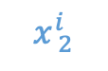
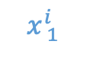
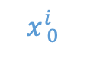
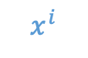
Neural Network Notation
$$x_{ }^{i}$$
$$x_{ 0}^{i}$$
$$x_{ 1}^{i}$$
$$x_{ 2}^{i}$$
Modified from Stanford CS231n

Slide 40
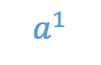
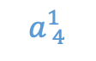
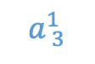
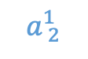
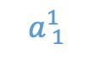
Neural Network Notation
$$a_{ }^{1}$$
$$x_{ }^{i}$$
$$a_{ 1}^{1}$$
$$x_{ 0}^{i}$$
$$a_{ 2}^{1}$$
$$x_{ 1}^{i}$$
$$a_{ 3}^{1}$$
$$x_{ 2}^{i}$$
$$a_{ 4}^{1}$$
Modified from Stanford CS231n

Slide 41
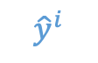
Neural Network Notation
$$a_{ }^{1}$$
$$x_{ }^{i}$$
$$a_{ 1}^{1}$$
$$x_{ 0}^{i}$$
$${\hat{y}}_{ }^{i}$$
$$a_{ 2}^{1}$$
$$x_{ 1}^{i}$$
$$a_{ 3}^{1}$$
$$x_{ 2}^{i}$$
$$a_{ 4}^{1}$$
Modified from Stanford CS231n

Slide 42

Neural Network Notation
$$a_{ }^{1}$$
$$x_{ }^{i}$$
$$w_{ }^{1}$$
$$a_{ 1}^{1}$$
$$x_{ 0}^{i}$$
$${\hat{y}}_{ }^{i}$$
$$a_{ 2}^{1}$$
$$x_{ 1}^{i}$$
$$a_{ 3}^{1}$$
$$x_{ 2}^{i}$$
$$a_{ 4}^{1}$$
Modified from Stanford CS231n

Slide 43
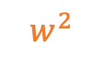
Neural Network Notation
$$a_{ }^{1}$$
$$x_{ }^{i}$$
$$w_{ }^{1}$$
$$w_{ }^{2}$$
$$a_{ 1}^{1}$$
$$x_{ 0}^{i}$$
$${\hat{y}}_{ }^{i}$$
$$a_{ 2}^{1}$$
$$x_{ 1}^{i}$$
$$a_{ 3}^{1}$$
$$x_{ 2}^{i}$$
$$a_{ 4}^{1}$$
Modified from Stanford CS231n

Slide 44
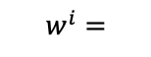
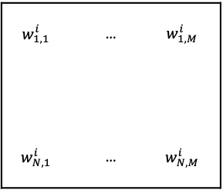
Neural Network Notation
$$a_{ }^{1}$$
$$x_{ }^{i}$$
$$w_{ }^{1}$$
$$w_{ }^{2}$$
$$a_{ 1}^{1}$$
$$x_{ 0}^{i}$$
$${\hat{y}}_{ }^{i}$$
$$a_{ 2}^{1}$$
$$w_{1,1}^{i}$$ | … | $$w_{1,M}^{i}$$
$$w_{N,1}^{i}$$ | … | $$w_{N,M}^{i}$$
$$x_{ 1}^{i}$$
$$a_{ 3}^{1}$$
$$w_{ }^{i}=$$
…
…
…
$$x_{ 2}^{i}$$
$$a_{ 4}^{1}$$
N is number of neurons in input and M is number of neurons in output
Modified from Stanford CS231n

Slide 45
Neural Network Notation
$$a_{ }^{1}$$
$$x_{ }^{i}$$
$$w_{ }^{1}$$
$$w_{ }^{2}$$
$$a_{ 1}^{1}$$
$$x_{ 0}^{i}$$
$${\hat{y}}_{ }^{i}$$
$$a_{ 2}^{1}$$
$$w_{1,1}^{i}$$ | … | $$w_{1,M}^{i}$$
$$w_{N,1}^{i}$$ | … | $$w_{N,M}^{i}$$
$$x_{ 1}^{i}$$
$$a_{ 3}^{1}$$
$$w_{ }^{i}=$$
…
…
…
$$x_{ 2}^{i}$$
$$a_{ 4}^{1}$$
N is number of neurons in input and M is number of neurons in output
Modified from Stanford CS231n
N x 1

Slide 46
Neural Network Notation
$$a_{ }^{1}$$
$$x_{ }^{i}$$
$$w_{ }^{1}$$
$$w_{ }^{2}$$
$$a_{ 1}^{1}$$
$$x_{ 0}^{i}$$
$${\hat{y}}_{ }^{i}$$
$$a_{ 2}^{1}$$
$$w_{1,1}^{i}$$ | … | $$w_{1,M}^{i}$$
$$w_{N,1}^{i}$$ | … | $$w_{N,M}^{i}$$
$$x_{ 1}^{i}$$
$$a_{ 3}^{1}$$
$$w_{ }^{i}=$$
…
…
…
$$x_{ 2}^{i}$$
$$a_{ 4}^{1}$$
N is number of neurons in input and M is number of neurons in output
Modified from Stanford CS231n
N x 1
N x M

Slide 47
Neural Network Notation
$$a_{ }^{1}$$
$$x_{ }^{i}$$
$$w_{ }^{1}$$
$$w_{ }^{2}$$
$$a_{ 1}^{1}$$
$$x_{ 0}^{i}$$
$${\hat{y}}_{ }^{i}$$
$$a_{ 2}^{1}$$
$$w_{1,1}^{i}$$ | … | $$w_{1,M}^{i}$$
$$w_{N,1}^{i}$$ | … | $$w_{N,M}^{i}$$
$$x_{ 1}^{i}$$
$$a_{ 3}^{1}$$
$$w_{ }^{i}=$$
…
…
…
$$x_{ 2}^{i}$$
$$a_{ 4}^{1}$$
N is number of neurons in input and M is number of neurons in output
Modified from Stanford CS231n
N x 1
N x M
M x 1

Slide 48
Training Multi-Layer Networks
$$a_{ }^{1}$$
$$x_{ }^{i}$$
$$w_{ }^{1}$$
$$w_{ }^{2}$$
$${\hat{y}}_{ }^{i}$$
Modified from Stanford CS231n

Slide 49
Training Multi-Layer Networks
$$a_{ }^{1}$$
$$x_{ }^{i}$$
$$w_{ }^{1}$$
$$w_{ }^{2}$$
How many weights?
$${\hat{y}}_{ }^{i}$$
Modified from Stanford CS231n

Slide 50
Training Multi-Layer Networks
$$a_{ }^{1}$$
$$x_{ }^{i}$$
$$w_{ }^{1}$$
$$w_{ }^{2}$$
How many weights?
input layer → hidden layer:
3 x 4 = 12 connections/weights
hidden layer → output layer:
4 x 1 = 4 connections/weights
In building NNets, we have to optimize/tune all these weights!
$${\hat{y}}_{ }^{i}$$
Modified from Stanford CS231n

Slide 51
Training Multi-Layer Networks
$$a_{ }^{1}$$
$$x_{ }^{i}$$
$$w_{ }^{1}$$
$$w_{ }^{2}$$
Remember Rosenblatt’s Algorithm:
It updated weights at once
Why is this an issue?
Our inputs for one layer are outputs from another
$${\hat{y}}_{ }^{i}$$
Modified from Stanford CS231n

Slide 52
Training Multi-Layer Networks
$$a_{ }^{1}$$
$$x_{ }^{i}$$
$$w_{ }^{1}$$
$$w_{ }^{2}$$
Remember Rosenblatt’s Algorithm:
It updated weights at once
Why is this an issue?
Our inputs for one layer are outputs from another
$${\hat{y}}_{ }^{i}$$
Modified from Stanford CS231n
a¹= threshold((w¹)^{T}x)

Slide 53
Training Multi-Layer Networks
$$a_{ }^{1}$$
$$x_{ }^{i}$$
$$w_{ }^{1}$$
$$w_{ }^{2}$$
Remember Rosenblatt’s Algorithm:
It updated weights at once
Why is this an issue?
Our inputs for one layer are outputs from another
$${\hat{y}}_{ }^{i}$$
Modified from Stanford CS231n
a¹= threshold((w¹)^{T}x)
a¹= φ¹((w¹)^{T}x)

Slide 54
Training Multi-Layer Networks
$$a_{ }^{1}$$
$$x_{ }^{i}$$
$$w_{ }^{1}$$
$$w_{ }^{2}$$
Remember Rosenblatt’s Algorithm:
It updated weights at once
Why is this an issue?
Our inputs for one layer are outputs from another
$${\hat{y}}_{ }^{i}$$
Modified from Stanford CS231n
a¹= threshold((w¹)^{T}x)
a¹= φ¹((w¹)^{T}x)
ŷ = φ²((w²)^{T}a¹)

Slide 55
Training Multi-Layer Networks
$$a_{ }^{1}$$
$$x_{ }^{i}$$
$$w_{ }^{1}$$
$$w_{ }^{2}$$
Remember Rosenblatt’s Algorithm:
It updated weights at once
Why is this an issue?
Our inputs for one layer are outputs from another
$${\hat{y}}_{ }^{i}$$
Modified from Stanford CS231n
a¹= threshold((w¹)^{T}x)
a¹= φ¹((w¹)^{T}x)
ŷ = φ²((w²)^{T}a¹) = φ²((w²)^{T} φ¹((w¹)^{T}x))

Slide 56
Activation Functions
Thus far, we’ve spoken about “thresholding” our outputs
We have looked at a step function to do this

Slide 57
Activation Functions
Thus far, we’ve spoken about “thresholding” our outputs
We have looked at a step function to do this
1
0

Slide 58
Activation Functions
Thus far, we’ve spoken about “thresholding” our outputs
We have looked at a step function to do this
There are some issues with using the step function, however
We’re going to set weights for our network – we will want something differentiable

Slide 59
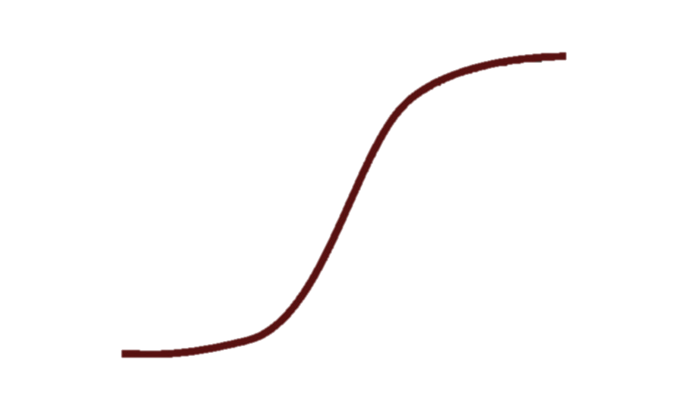
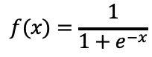
Activation Functions
Thus far, we’ve spoken about “thresholding” our outputs
We have looked at a step function to do this
There are some issues with using the step function, however
We’re going to set weights for our network – we will want something differentiable
One alternative:
Sigmoid function
1
$$f(x)=\frac{1}{1+e^{−x}}$$
0

Slide 60
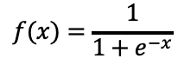
Activation Functions
Thus far, we’ve spoken about “thresholding” our outputs
We have looked at a step function to do this
There are some issues with using the step function, however
We’re going to set weights for our network – we will want something differentiable
One alternative:
Sigmoid function
Makes our threshold = 0.5 (0 is easier to work with)
Has a vanishing gradient problem at extremes
1
$$f(x)=\frac{1}{1+e^{−x}}$$
0

Slide 61
Activation Functions
Thus far, we’ve spoken about “thresholding” our outputs
We have looked at a step function to do this
There are some issues with using the step function, however
We’re going to set weights for our network – we will want something differentiable
One alternative:
tanh function
Has a vanishing gradient problem at extremes
1
-1

Slide 62
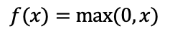
Activation Functions
Thus far, we’ve spoken about “thresholding” our outputs
We have looked at a step function to do this
There are some issues with using the step function, however
We’re going to set weights for our network – we will want something differentiable
One alternative:
ReLu function
1
Piecewise differentiable
No vanishing gradient problem at extremes
However, hard to learn when inputs are negative
$$f(x)=max⁡(0, x)$$
0

Slide 63
Training Multi-Layer Networks
$$a_{ }^{1}$$
$$x_{ }^{i}$$
$$w_{ }^{1}$$
$$w_{ }^{2}$$
Remember Rosenblatt’s Algorithm:
It updated weights at once
Why is this an issue?
Our inputs for one layer are outputs from another
$${\hat{y}}_{ }^{i}$$
Modified from Stanford CS231n
a¹= threshold((w¹)^{T}x)
a¹= φ¹((w¹)^{T}x)
ŷ = φ²((w²)^{T}a¹) = φ²((w²)^{T} φ¹((w¹)^{T}x))

Slide 64
Review: Gradient Descent
Express your learning problem in terms of a cost function that should be minimized
Starting at initial point, step “downhill” until you reach a minimum
Some situations offer a guarantee that the minimum is the global minimum, others don’t

Slide 65
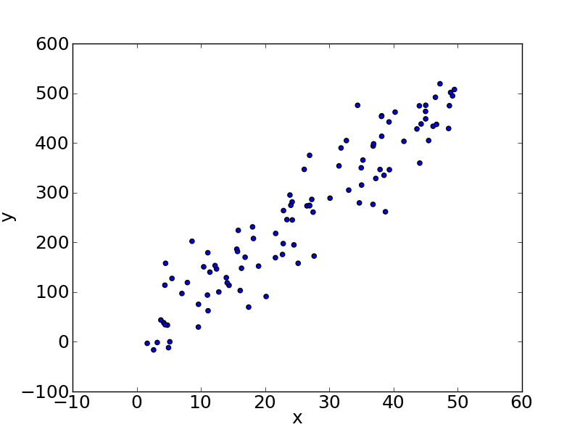
Ex: Gradient Descent for Linear Regression
input variable
response
variable
X | y
3.1 | 84.2
19.6 | 175.8
45.9 | 448.3
6.8 | 50.4
3.5 | 81.9
… | …

Slide 66
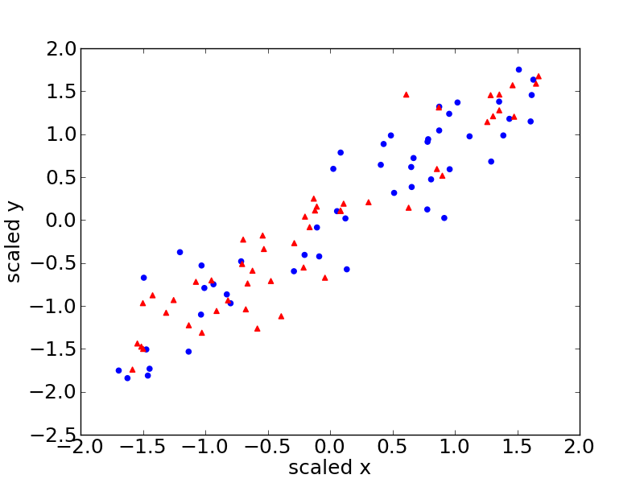
Set aside test data….

Slide 67
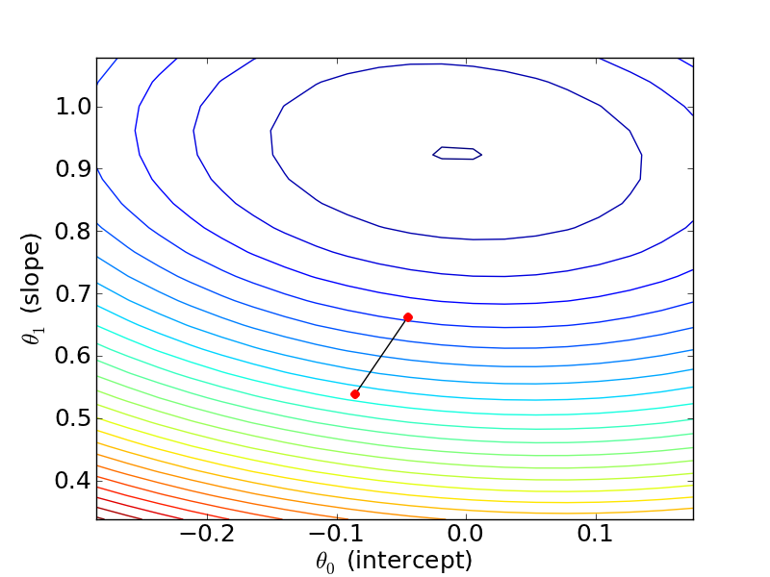
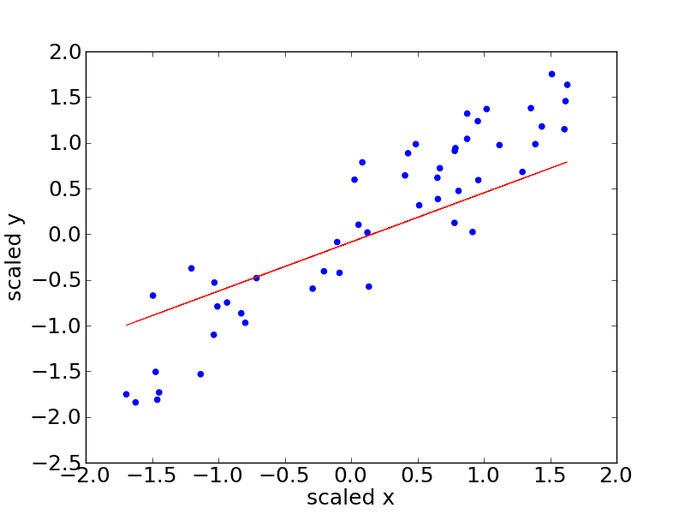
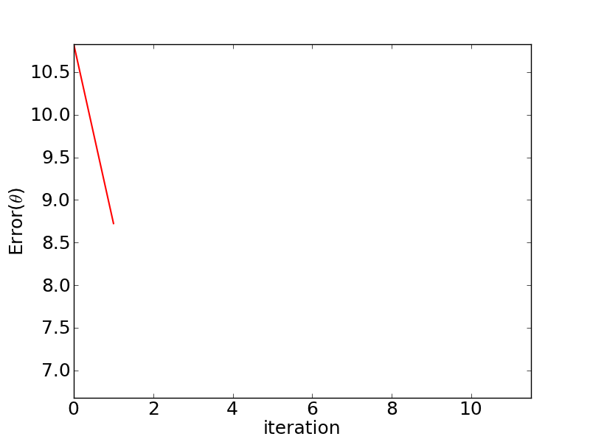

Slide 68
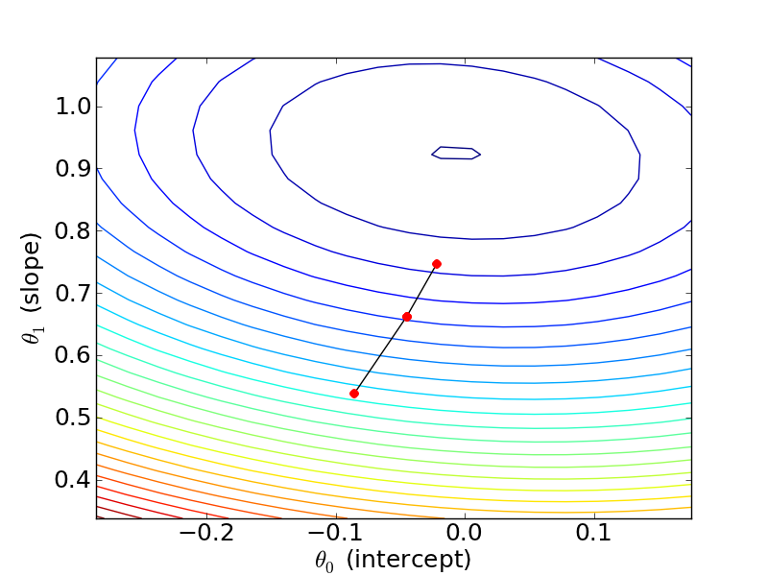
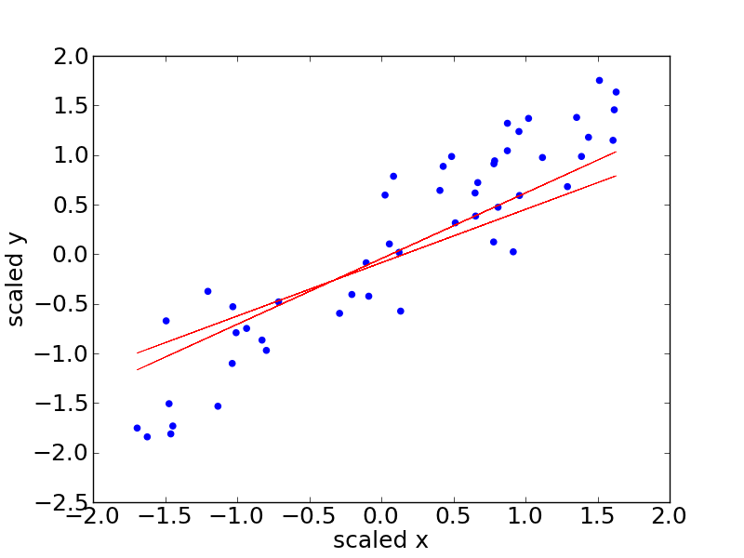
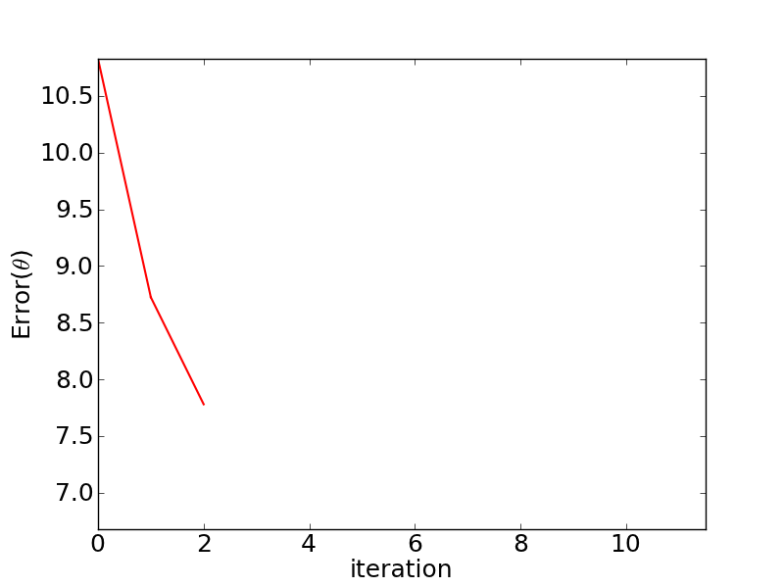

Slide 69
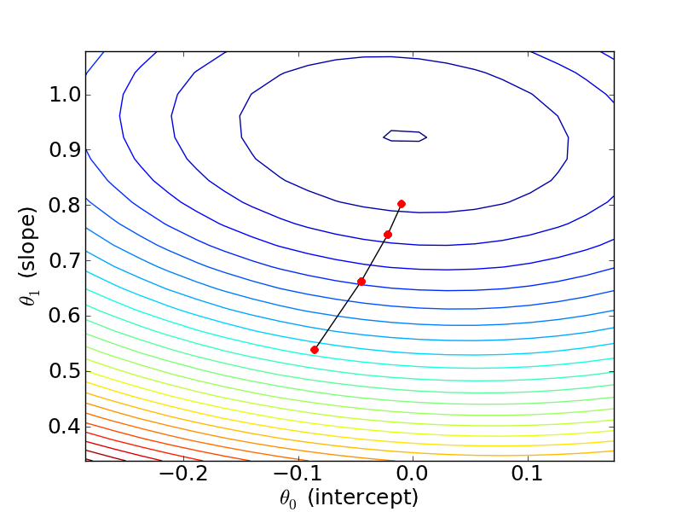

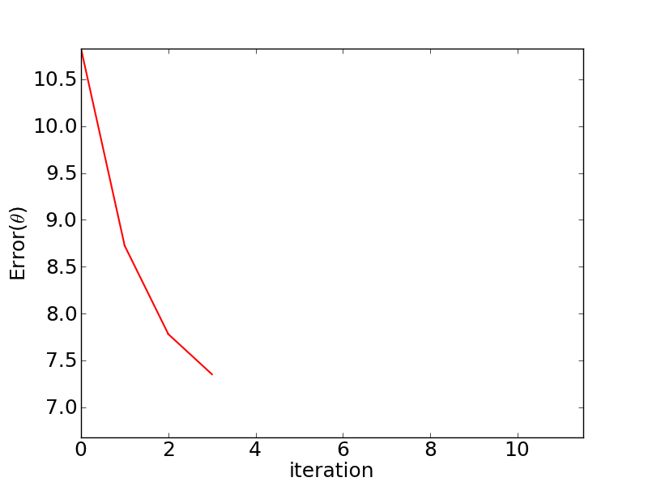

Slide 70
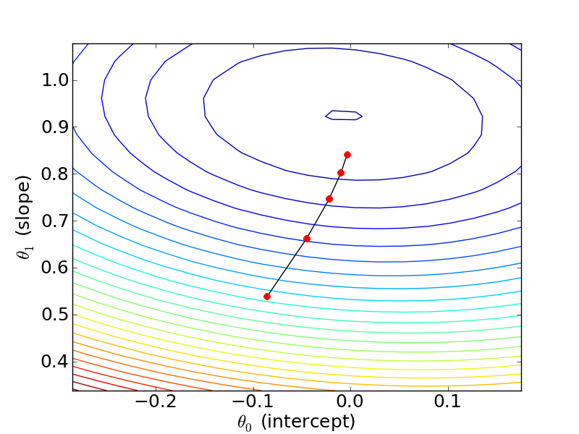
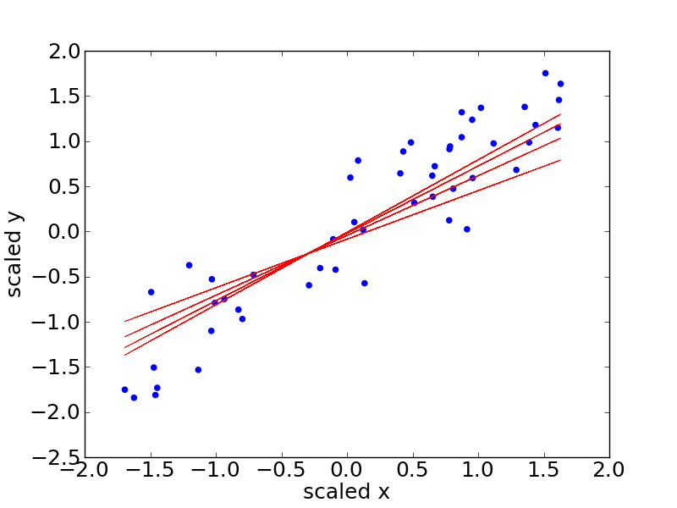
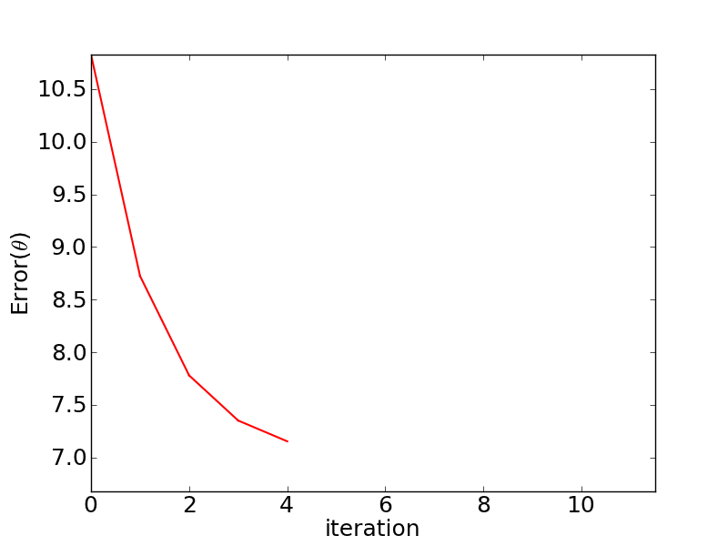

Slide 71
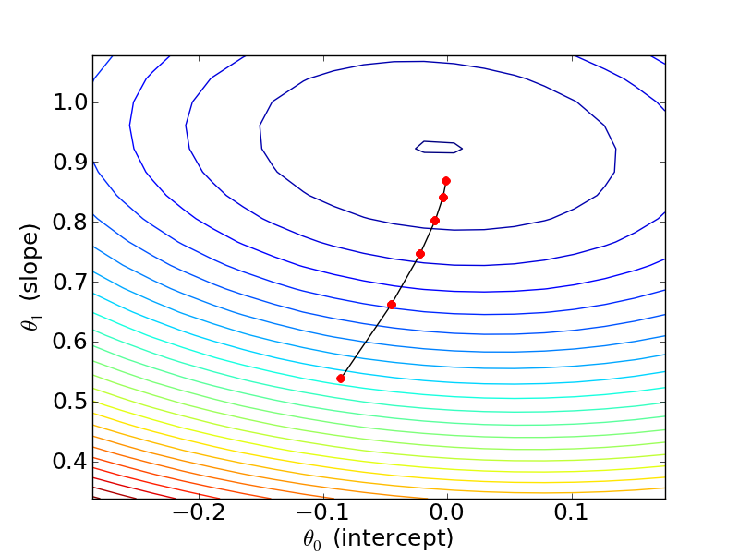
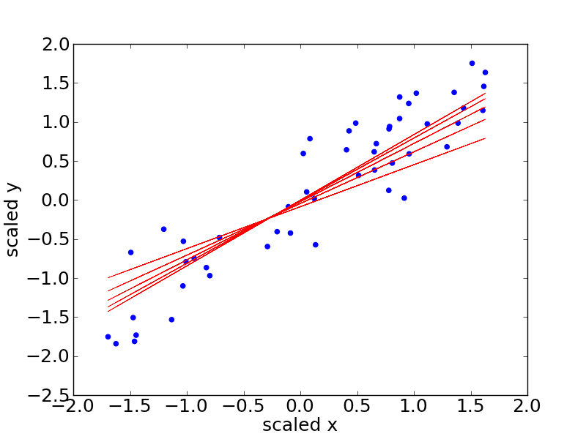
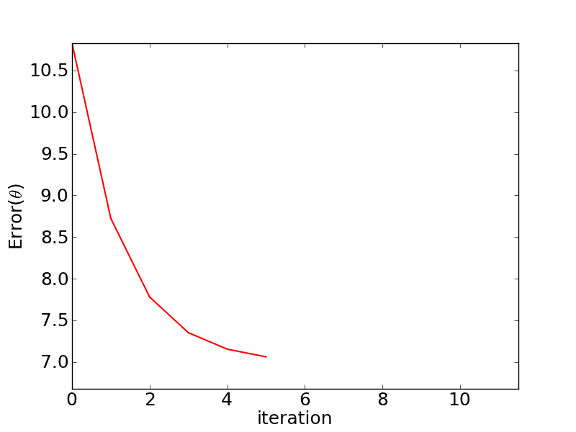

Slide 72
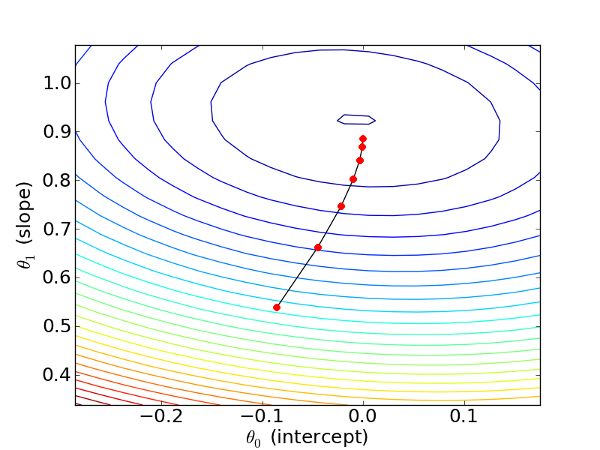
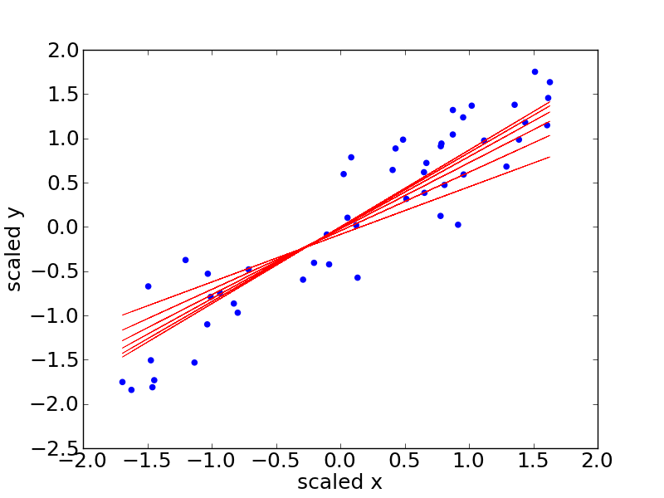
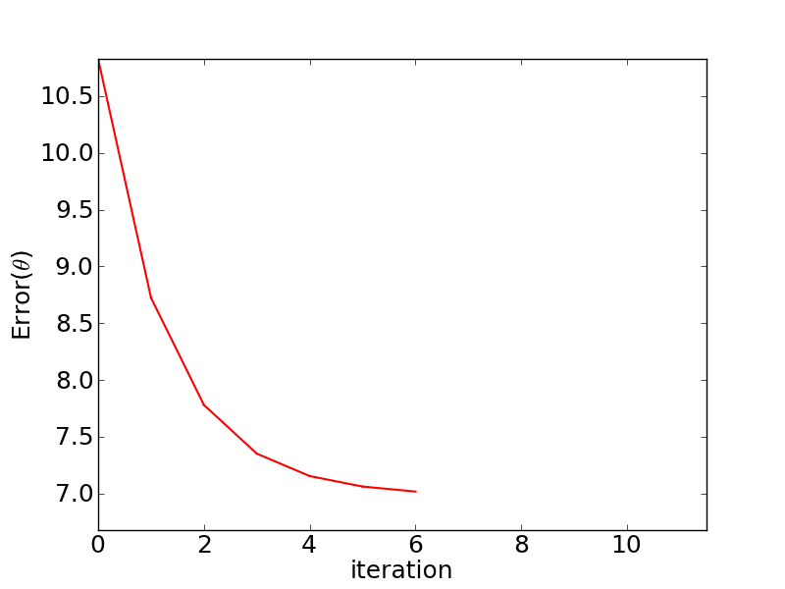

Slide 73



Notes:
y= \theta^{(i)}_0 + \theta_1^{(i)}x
Err(i) = \sum^n_{k=1} (y_k - (\theta^{(i)}_0 + \theta_1^{(i)}x_k))^2

Slide 75
Notes:
\theta^{(i+1)}_0 \leftarrow \theta^{(i)}_0 + \alpha\frac{\delta}{\delta\theta_0}J(\theta^{(i)})
\theta^{(i+1)}_1 \leftarrow \theta^{(i)}_1 + \alpha\frac{\delta}{\delta\theta_1}J(\theta^{(i)})
(\theta^{(2)}_0, \theta^{(2)}_1)

Slide 76
Learning Rate
Cost Function
Gradient
Notes:
\theta^{(i+1)}_0 \leftarrow \theta^{(i)}_0 + \alpha\frac{\delta}{\delta\theta_0}J(\theta^{(i)})

Slide 77
Model at i
Learning Rate
Gradient
Cost Function
Notes:
\theta^{(i+1)}_0 \leftarrow \theta^{(i)}_0 + \alpha\frac{\delta}{\delta\theta_0}\frac{1}{2}\sum^n_{k=1}(h^{(i)}(x_k) – y_k)^2

Slide 78
Taking the derivative!
Notes:
&\frac{\delta}{\delta\theta_1}\frac{1}{2}\sum^n_{k=1}(h(x_k) - y_k)^2 \\
&\sum^n_{k=1}2\frac{1}{2}(h(x_k) - y_k)\frac{\delta}{\delta\theta_1}(h(x_k) - y_k) \\
&\sum^n_{k=1}(h(x_k) - y_k)\frac{\delta}{\delta\theta_1}(\theta_0 + \theta_1x_k- y_k) \\
&\sum^n_{k=1}(h(x_k) - y_k)x_k \\

Slide 79
Notes:
\theta^{(i+1)}_0 \leftarrow \theta^{(i)}_0 + \alpha\frac{\delta}{\delta\theta_0}\frac{1}{2}\sum^n_{k=1}(h^{(i)}(x_k) – y_k)^2
\theta^{(i+1)}_1 \leftarrow \theta^{(i)}_1 + \alpha\sum^n_{k=1}(\theta_0 + \theta_1(x_k) - y_k)x_k

Slide 80
while not converged:
* 1.0
Notes:
\theta^{(i+1)}_0 \leftarrow \theta^{(i)}_0 + \alpha\sum^n_{k=1}(\theta^{(i)}_0 + \theta^{(i)}_1(x_k) - y_k)

Slide 81
END

Slide 82
Training Multi-Layer Networks
$$a_{ }^{1}$$
$$x_{ }^{i}$$
$$w_{ }^{1}$$
$$w_{ }^{2}$$
Remember Rosenblatt’s Algorithm:
It updated weights at once
Why is this an issue?
Our inputs for one layer are outputs from another
$${\hat{y}}_{ }^{i}$$
a¹= threshold((w¹)^{T}x)
a¹= φ¹((w¹)^{T}x)
ŷ = φ²((w²)^{T}a¹) = φ²((w²)^{T} φ¹((w¹)^{T}x))
Modified from Stanford CS231n

Slide 83
Training Multi-Layer Networks
Steps to train a neural network:

Slide 84
Training Multi-Layer Networks
Steps to train a neural network:
Forward propagation
Pass the input data through the network and calculate predictions (ŷ)
Basically “make predictions”

Slide 85
Training Multi-Layer Networks
Steps to train a neural network:
Forward propagation
Pass the input data through the network and calculate predictions (ŷ)
Basically “make predictions”
Calculate error
Determine how far off from y we are with ŷ

Slide 86
Training Multi-Layer Networks
Steps to train a neural network:
Forward propagation
Pass the input data through the network and calculate predictions (ŷ)
Basically “make predictions”
Calculate error
Determine how far off from y we are with ŷ
Backpropogation (Backward propogation)
Update weights/biases based on our error

Slide 87
Training Multi-Layer Networks
Steps to train a neural network:

Slide 88
Training Multi-Layer Networks
Steps to train a neural network:
Forward Propagation

Slide 89
Training Multi-Layer Networks
Steps to train a neural network:
Forward Propagation
Calculate Error

Slide 90
Training Multi-Layer Networks
Steps to train a neural network:
Forward Propagation
Calculate Error
Backward Propagation

Slide 91
Training Multi-Layer Networks
Steps to train a neural network:
Forward Propagation
Repeat for a predetermined number of “epochs” (cycles/iterations)
Calculate Error
Backward Propagation

Slide 92
Forward Propagation
For our first iteration (epoch), start with some randomization of weights and biases
For subsequent epochs, use weights/biases from backpropagation
Take our inputs and propagate through our architecture to generate our initial predictions
Inputs propagate through all layers until we reach our output layer
Note that for our first iteration, these outputs will (likely) not be very useful because they’re based on random weights/biases

Slide 93
Calculate Loss
To calculate loss, first we need y (this is given)
Then we need ŷ (which we calculate using forward propogation)
Then we need a loss function
A loss (cost) function is the objective function – it is what we want to minimize (or maximize, depending on context)
There are many (many) possible loss functions. Some common ones:
For regression:
Mean squared error loss (hopefully you’ve seen/remember this)
Mean absolute error loss
For classification:
Cross-entropy loss, aka log loss (related to maximum likelihood estimation)
Hinge loss (typically only for binary classification)

Slide 94

How Loss Ties To Backpropagation
Ideally, we want to minimize loss
Example: C(w) = ($\frac{1}{N}\sum_{1}^{N}{{(y−\hat{y})}^{2}}$), where ŷ are outputs based on my current w
For many cases, this can be straightforward:
C(w)

Slide 95
How Loss Ties To Backpropagation
Ideally, we want to minimize loss
Example: C(w) = ($\frac{1}{N}\sum_{1}^{N}{{(y−\hat{y})}^{2}}$), where ŷ are outputs based on my current w
For many cases, this can be straightforward:
Min of C(w)
C(w)
dC/dw (w) = 0

Slide 96

How Loss Ties To Backpropagation
Ideally, we want to minimize loss
Example: C(w) = ($\frac{1}{N}\sum_{1}^{N}{{(y−\hat{y})}^{2}}$), where ŷ are outputs based on my current w
For many cases, this can be straightforward. For other cases, this can be very challenging
C(w)

Slide 97
How Loss Ties To Backpropagation
Ideally, we want to minimize loss
Example: C(w) = ($\frac{1}{N}\sum_{1}^{N}{{(y−\hat{y})}^{2}}$), where ŷ are outputs based on my current w
For many cases, this can be straightforward. For other cases, this can be very challenging
Min of C(w)
dC/dw (w) = 0
C(w)

Slide 98
How Loss Ties To Backpropagation
Ideally, we want to minimize loss
Example: C(w) = ($\frac{1}{N}\sum_{1}^{N}{{(y−\hat{y})}^{2}}$), where ŷ are outputs based on my current w
For many cases, this can be straightforward. For other cases, this can be very challenging
Min of C(w)
dC/dw (w) = 0
C(w)

Slide 99
How Loss Ties To Backpropagation
Ideally, we want to minimize loss
Example: C(w) = ($\frac{1}{N}\sum_{1}^{N}{{(y−\hat{y})}^{2}}$), where ŷ are outputs based on my current w
For many cases, this can be straightforward. For other cases, this can be very challenging
Min of C(w)
dC/dw (w) = 0
C(w)

Slide 100

How Loss Ties To Backpropagation
Ideally, we want to minimize loss
Example: C(w) = ($\frac{1}{N}\sum_{1}^{N}{{(y−\hat{y})}^{2}}$), where ŷ are outputs based on my current w
For many cases, this can be straightforward. For other cases, this can be very challenging
General idea: we randomly pick a point to start (based on our initial weights/biases) and from there, we incrementally take steps towards a local minima of the cost function
This is gradient descent, with the gradient representing the “slope” of the cost function in n-dimensional space

Slide 101
More On The Loss Function

Slide 102
More On The Loss Function
21 parameter model (16 weights + 5 biases)

Slide 103
More On The Loss Function
21 parameter model (16 weights + 5 biases)
Our ŷ is, in essence, a function of this 21 parameter space

Slide 104
More On The Loss Function
21 parameter model (16 weights + 5 biases)
Our ŷ is, in essence, a function of this 21 parameter space
Our C(w) is also a function of this 21 parameter space

Slide 105


More On The Loss Function
21 parameter model (16 weights + 5 biases)
Our ŷ is, in essence, a function of this 21 parameter space
Our C(w) is also a function of this 21 parameter space
Calculating gradient
$$\begin{matrix}w_{0} \\ ⋮ \\ w_{21}\end{matrix}$$
$$\begin{matrix}w_{0} \\ ⋮ \\ w_{21}\end{matrix}$$
C( )
Δ
C( )

Slide 106
More On The Loss Function
21 parameter model (16 weights + 5 biases)
Our ŷ is, in essence, a function of this 21 parameter space
Our C(w) is also a function of this 21 parameter space
For each element of the gradient:
Sign (+/-) indicates whether that weight should increase/decrease
Magnitude indicates how much it should change
Calculating gradient
$$\begin{matrix}w_{0} \\ ⋮ \\ w_{21}\end{matrix}$$
$$\begin{matrix}w_{0} \\ ⋮ \\ w_{21}\end{matrix}$$
C( )
Δ
C( )

Slide 107

Backpropagation
Output = φ($w_{1}^{2}a_{1}^{1}+w_{2}^{2}a_{2}^{1}+…++w_{n}^{2}a_{n}^{1}+b_{1}^{2}$)

Slide 108

Backpropagation
Output = φ($w_{1}^{2}a_{1}^{1}+w_{2}^{2}a_{2}^{1}+…++w_{n}^{2}a_{n}^{1}+b_{1}^{2}$)
In essence, three adjustments we can make:
Change the bias
Change the weights
Change the values of a

Slide 109

Backpropagation
Output = φ($w_{1}^{2}a_{1}^{1}+w_{2}^{2}a_{2}^{1}+…++w_{n}^{2}a_{n}^{1}+b_{1}^{2}$)
In essence, three adjustments we can make:
Change the bias
Change the weights
Change the values of a (which is actually the output of the layer previous to it)

Slide 110

Backpropagation
Output = φ($w_{1}^{2}a_{1}^{1}+w_{2}^{2}a_{2}^{1}+…++w_{n}^{2}a_{n}^{1}+b_{1}^{2}$)
In essence, three adjustments we can make:
Change the bias
Change the weights
Change the values of a (which is actually the output of the layer previous to it)
Backpropagation does all three

Slide 111
Backpropagation
Output = φ($w_{1}^{2}a_{1}^{1}+w_{2}^{2}a_{2}^{1}+…++w_{n}^{2}a_{n}^{1}+b_{1}^{2}$)

Slide 112

Backpropagation
Output = φ($w_{1}^{2}a_{1}^{1}+w_{2}^{2}a_{2}^{1}+…++w_{n}^{2}a_{n}^{1}+b_{1}^{2}$)
Cost = (y – ŷ)² = (y – Output)² = (y – φ($z_{1}^{2}$))²

Slide 113

Backpropagation
Output = φ($w_{1}^{2}a_{1}^{1}+w_{2}^{2}a_{2}^{1}+…++w_{n}^{2}a_{n}^{1}+b_{1}^{2}$)
Cost = (y – ŷ)² = (y – Output)² = (y – φ($z_{1}^{2}$))²
For any one layer:
$aL$ = φ($z^{L}$) = φ($w^{L}a^{(L−1)}+b^{L}$)

Slide 114

Backpropagation
Output = φ($w_{1}^{2}a_{1}^{1}+w_{2}^{2}a_{2}^{1}+…++w_{n}^{2}a_{n}^{1}+b_{1}^{2}$)
Cost = (y – ŷ)² = (y – Output)² = (y – φ($z_{1}^{2}$))²
For any one layer:
$aL$ = φ($z^{L}$) = φ($w^{L}a^{(L−1)}+b^{L}$)
Where:
$a^{(L−1)}$= φ($z^{(L−1)}$) = φ($w^{(L−1)}a^{(L−2)}+b^{(L−1)}$)

Slide 115

Backpropagation
Sebastian Raschka

Slide 116
Backpropagation
x
w
Sebastian Raschka

Slide 117
Backpropagation
x
w
Sebastian Raschka

Slide 118
Backpropagation
Repeat as desired
x
w
Sebastian Raschka

Slide 119
Backpropagation
Cost
Target
Output
Repeat as desired
x
w
Sebastian Raschka

Slide 120
Backpropagation
Output = φ($w_{1}^{2}a_{1}^{1}+w_{2}^{2}a_{2}^{1}+…++w_{n}^{2}a_{n}^{1}+b_{1}^{2}$)
Cost = (y – ŷ)² = (y – Output)² = (y – φ($z_{1}^{2}$))²
For any one layer:
$aL$ = φ($z^{L}$) = φ($w^{L}a^{(L−1)}+b^{L}$)

Slide 121

Backpropagation
Output = φ($w_{1}^{2}a_{1}^{1}+w_{2}^{2}a_{2}^{1}+…++w_{n}^{2}a_{n}^{1}+b_{1}^{2}$)
Cost = (y – ŷ)² = (y – Output)² = (y – φ($z_{1}^{2}$))²
For any one layer:
$aL$ = φ($z^{L}$) = φ($w^{L}a^{(L−1)}+b^{L}$)
$z^{L}$ = $w^{L}a^{(L−1)}+b^{L}$

Slide 122

Backpropagation
Output = φ($w_{1}^{2}a_{1}^{1}+w_{2}^{2}a_{2}^{1}+…++w_{n}^{2}a_{n}^{1}+b_{1}^{2}$)
Cost = (y – ŷ)² = (y – Output)² = (y – φ($z_{1}^{2}$))²
For any one layer:
$aL$ = φ($z^{L}$) = φ($w^{L}a^{(L−1)}+b^{L}$)
$z^{L}$ = $w^{L}a^{(L−1)}+b^{L}$
C = ($a^{N}−y$)²

Slide 123
Backpropagation
x
a¹
a²
w¹
w²

Slide 124
Backpropagation
x
a¹
a²
w¹
w²
z¹ = w¹x + b¹
z² = w²a¹ + b²

Slide 125
Backpropagation
x
a¹
a²
w¹
w²
z¹ = w¹x + b¹
z² = w²a¹ + b²
C(a^{N} – y)²
= C(φ(z²) - y)²
= C(φ(w²a¹ + b²) - y)²

Slide 126

Backpropagation
x
a¹
a²
w¹
w²
z¹ = w¹x + b¹
z² = w²a¹ + b²
C(a^{N} – y)²
= C(φ(z²) - y)²
= C(φ(w²a¹ + b²) - y)²
$\frac{∂C}{∂w^{2}}= \frac{∂z^{2}}{∂w^{2}}$ $\frac{∂a^{2}}{∂w^{2}}\frac{∂C}{∂a^{2}}$

Slide 127

Backpropagation
x
a¹
a²
w¹
w²
z¹ = w¹x + b¹
z² = w²a¹ + b²
C(a^{N} – y)²
= C(φ(z²) - y)²
= C(φ(w²a¹ + b²) - y)²
$\frac{∂C}{∂w^{2}}= \frac{∂z^{2}}{∂w^{2}}$ $\frac{∂a^{2}}{∂w^{2}}\frac{∂C}{∂a^{2}}$
= a¹φ’(z²)2(a² - y)

Slide 128

Backpropagation
x
a¹
a²
w¹
w²
z¹ = w¹x + b¹
z² = w²a¹ + b²
C(a^{N} – y)²
= C(φ(z²) - y)²
= C(φ(w²a¹ + b²) - y)²
$\frac{∂C}{∂w^{2}}= \frac{∂z^{2}}{∂w^{2}}$ $\frac{∂a^{2}}{∂w^{2}}\frac{∂C}{∂a^{2}}$
= a¹φ’(z²)2(a² - y)
$\frac{∂C}{∂b^{2}}= \frac{∂z^{2}}{∂b^{2}}$ $\frac{∂a^{2}}{∂w^{2}}\frac{∂C}{∂a^{2}}$ = φ’(z²)2(a² - y)

Slide 129
Backpropagation
x
a¹
a²
w¹
w²
z¹ = w¹x + b¹
z² = w²a¹ + b²
C(a^{N} – y)²
= C(φ(z²) - y)²
= C(φ(w²a¹ + b²) - y)²
$\frac{∂C}{∂w^{2}}= \frac{∂z^{2}}{∂w^{2}}$ $\frac{∂a^{2}}{∂w^{2}}\frac{∂C}{∂a^{2}}$
= a¹φ’(z²)2(a² - y)
$\frac{∂C}{∂b^{2}}= \frac{∂z^{2}}{∂b^{2}}$ $\frac{∂a^{2}}{∂w^{2}}\frac{∂C}{∂a^{2}}$ = φ’(z²)2(a² - y)
If we had more layers, we would have very repetitive calculations as we move backwards
Memoization can help store values for repetitive answers
General idea after this: keep iterating the same idea backwards for previous layers

Slide 130
Backpropagation
x
a¹
a²
w¹
w²
z¹ = w¹x + b¹
z² = w²a¹ + b²
C(a^{N} – y)²
= C(φ(z²) - y)²
= C(φ(w²a¹ + b²) - y)²
$\frac{∂C}{∂w^{2}}= \frac{∂z^{2}}{∂w^{2}}$ $\frac{∂a^{2}}{∂w^{2}}\frac{∂C}{∂a^{2}}$
= a¹φ’(z²)2(a² - y)
$\frac{∂C}{∂b^{2}}= \frac{∂z^{2}}{∂b^{2}}$ $\frac{∂a^{2}}{∂w^{2}}\frac{∂C}{∂a^{2}}$ = φ’(z²)2(a² - y)
If we had more layers, we would have very repetitive calculations as we move backwards
Memoization can help store values for repetitive answers
General idea after this: keep iterating the same idea backwards for previous layers

Slide 131
Training Multi-Layer Networks
Steps to train a neural network:
Forward Propagation
Repeat for a predetermined number of “epochs” (cycles/iterations)
Calculate Error
Backward Propagation

Slide 132


For More
3blue1brown
ml-cheatseet

Slide 133
END

Slide 134
The 2nd AI Winter
Sometime after the first AI Spring, a second AI Winter came about
Rough dates: late 1980s through early 90s

Slide 135
The 2nd AI Winter
Sometime after the first AI Spring, a second AI Winter came about
Rough dates: late 1980s through early 90s
Multi-layered networks could be trained (in theory); however, they took a lot of computational resources
Alternatively, there became a growing interest in SVMs and Bayesian approaches
At some point, NeurIPS (which was founded as a conference on neural networks) was accepting more papers in non-neural domains than neural domains

Slide 136
The 2nd AI Winter
Sometime after the first AI Spring, a second AI Winter came about
Rough dates: late 1980s through early 90s
Multi-layered networks could be trained (in theory); however, they took a lot of computational resources
Alternatively, there became a growing interest in SVMs and Bayesian approaches
At some point, NeurIPS (which was founded as a conference on neural networks) was accepting more papers in non-neural domains than neural domains
On the flip side, the commercialization of expert systems stalled

Slide 137
Deep Learning
Several developments led to the growth of deep learning and a renaissance for neural networks as a whole
Rethinking activation functions
1
1
0
0

Slide 138

Deep Learning
Several developments led to the growth of deep learning and a renaissance for neural networks as a whole
Rethinking activation functions
Video games
bountie.io

Slide 139
Deep Learning
Several developments led to the growth of deep learning and a renaissance for neural networks as a whole
Rethinking activation functions
Video games GPUs
bountie.io

Slide 140

Deep Learning
Several developments led to the growth of deep learning and a renaissance for neural networks as a whole
Rethinking activation functions
GPUs
More data

Slide 141

Deep Learning
Several developments led to the growth of deep learning and a renaissance for neural networks as a whole
Rethinking activation functions
GPUs
More data
Rebranding
deeplearning.net

Slide 142
Deep Learning
Several developments led to the growth of deep learning and a renaissance for neural networks as a whole
Rethinking activation functions
GPUs
More data
Rebranding
Many other advancements (especially in optimization theory/approaches)

Slide 143
Deep Learning
Remainder of this video: different ideas/concepts in neural networks
Preventing overfitting

Slide 144
Preventing Overfitting
General idea: when we train neural networks, we didn’t take into account overfitting
We can do this in several ways. Some of :
Limit the number of epochs
Hard to really get a sense of a good number beforehand
Can be a bit tricky to monitor in real-time training
Regularization: add a regularization term to the loss function
Will behave differently for different loss types
Will need to be tuned/tweaked
Add a dropout layer

Slide 145
Dropout
General idea: for each X, we randomly select nodes to remove from the network
We not only remove the nodes, but we also remove connections to the nodes
(In truth, we set the weights for these nodes to 0)
The dropout rate can vary for each layer but is usually based on some probability
Why does this work?
Hidden units cannot “co-adapt” to other units
Cannot rely on any one input, so we spread out weights
It’s much like working with a smaller neural network

Slide 146
Dropout

Slide 147
Dropout
Dropout = 0.25

Slide 148
Dropout
Iter 1
Dropout = 0.25

Slide 149
Dropout
Iter 1
Iter 2
Dropout = 0.25

Slide 150
Dropout
Iter 1
Iter 2
Dropout = 0.25
Iter 3

Slide 151
Deep Learning
Remainder of this video: different ideas/concepts in neural networks
Preventing overfitting
Autoencoders

Slide 152
Autoencoders
An autoencoder is a neural network whose output is the same as the input
What’s the point?
Dimensionality reduction
Using a more constrained model to represent data inputs
Can be used for clustering
Anomaly detection
If the autoencoder can’t reconstruct the output, maybe it’s dissimilar to the training data

Slide 153

Autoencoders
Jeremy Jordan

Slide 154
Deep Learning
Remainder of this video: different ideas/concepts in neural networks
Preventing overfitting
Autoencoders
Convolutional networks

Slide 155
Convolutional Networks
Convolutional neural networks are networks that employ a convolution function at some point
Yes, similar to the convolution used in signal processing
Focus on small, simple patterns in the data
Thus, they are very effective for images and videos
Allow us to take spatial structures into account
Generally involve successive convolution and pooling of features

Slide 156
Convolutional Layer
Can be thought of as a filter that passes over the input
This gets at the idea of focusing on locality – we focus on small activation maps

Slide 157

Convolutional Layer
Can be thought of as a filter that passes over the input
This gets at the idea of focusing on locality – we focus on small activation maps
Sumit Saha

Slide 158

Convolutional Layer
Can be thought of as a filter that passes over the input
This gets at the idea of focusing on locality – we focus on small activation maps
Sumit Saha

Slide 159

Convolutional Layer
Can be thought of as a filter that passes over the input
This gets at the idea of focusing on locality – we focus on small activation maps
Zero padding
Sumit Saha

Slide 160
Convolutional Layer
Can be thought of as a filter that passes over the input
This gets at the idea of focusing on locality – we focus on small activation maps
Stride
Zero padding
Sumit Saha

Slide 161
Convolutional Layer
Can be thought of as a filter that passes over the input
This gets at the idea of focusing on locality – we focus on small activation maps
Stride
Zero padding
Sumit Saha

Slide 162
Convolutional Layer
Can be thought of as a filter that passes over the input
This gets at the idea of focusing on locality – we focus on small activation maps
Stride
Zero padding
Sumit Saha

Slide 163
Pooling Layer
Often a max-pooling process is applied thereafter to reduce the size of the convolved features. Avg pooling can also be applied

Slide 164


Pooling Layer
Often a max-pooling process is applied thereafter to reduce the size of the convolved features. Avg pooling can also be applied
Sumit Saha
Sumit Saha

Slide 165

Convolutional Network Architecture
Sumit Saha

Slide 166

Convolutional Network Architecture
Sumit Saha

Slide 167


Convolutional Network Architecture

Slide 168
Deep Learning
Remainder of this video: different ideas/concepts in neural networks
Preventing overfitting
Autoencoders
Deep convolutional networks
Recurrent neural networks

Slide 169

Recurrent Neural Networks
Take in an input as a temporal sequence
The order of the input matters and can aid in predictions
Thus, they are very effective for tasks involving natural language
Michael Nguyen

Slide 170

Recurrent Neural Networks
fdeloche

Slide 171

Recurrent Neural Networks
Michael Nguyen

Slide 172

Recurrent Neural Networks
Michael Nguyen

Slide 173

Recurrent Neural Networks
Michael Nguyen

Slide 174

Recurrent Neural Networks
Michael Nguyen

Slide 175
Recurrent Neural Networks
Michael Nguyen

Slide 176

Recurrent Neural Networks
Michael Nguyen

Slide 177



Recurrent Neural Networks

Slide 178
Deep Learning
Remainder of this video: different ideas/concepts in neural networks
Preventing overfitting
Autoencoders
Deep convolutional networks
Recurrent neural networks
Generative adversarial neural networks

Slide 179

Generative Adversarial Networks
Broadly: composed of two neural networks
A generator neural network which generates data
A discriminator neural network which classifies data
Google

Slide 180

Generative Adversarial Networks
The generator learns to generate plausible data
Its job is to fool the discriminator
The discriminator learns to distinguish the generator’s data from real data
Its job is to detect data from the generator
Google

Slide 181
Generative Adversarial Networks
The generator learns to generate plausible data
Its job is to fool the discriminator
The discriminator learns to distinguish the generator’s data from real data
Its job is to detect data from the generator
Google

Slide 182
Generative Adversarial Networks
The generator learns to generate plausible data
Its job is to fool the discriminator
The discriminator learns to distinguish the generator’s data from real data
Its job is to detect data from the generator
Google

Slide 183
Generative Adversarial Networks
The generator learns to generate plausible data
Its job is to fool the discriminator
The discriminator learns to distinguish the generator’s data from real data
Its job is to detect data from the generator
Google

Slide 184
Generative Adversarial Networks
What’s the point?
To generate synthetic data!

Slide 185



Generative Adversarial Networks
Derpfakes
What’s the point?
To generate synthetic data!
Samsung
Kim et al

Slide 186

Generative Adversarial Networks
www.whichfaceisreal.com

Slide 187
Generative Adversarial Networks
www.whichfaceisreal.com

Slide 188
Summing Up
Many reasons for the 2nd AI Spring including increased computational power and resources
A few ways to combat overfitting: limit epochs, regularize, dropout
Many flavors of neural networks
Autoencoders: train the outputs to be like the inputs
Convolutional nets: look for patterns across localities of the input (images)
Recurrent nets: have inputs that are sequences (text)
GANs: use two networks in competition with each other (generate data)

